Slide 1


Business Intelligence (Data Science)
Cinema rating from sentiments perspective
Authors:
Juan Eduardo Rioja
Luis Enrique Ostos
Yesenia Becerra

Slide 2

Business Intelligence (Data Science)
Introduction
The purpose of this analysis is to try a tool that helps to classify the sentiment of a phrase, so we could answer the question if is possible to understand which movie is the most popular by the audience and know if this tool provides the enough knowledge to select the top movie by the audience.
To achieve this, we used data gathered from Twitter APIs and Stanford CoreNLP to assign a sentiment rating

Slide 3
Business Intelligence (Data Science)
Introduction
The social network Twitter, is one of the most popular service that provide to the user the creation of microblogging service where the users can create short messages as status, know them as tweets. Commonly the tweets express the opinions from the users about different topics.
The team from Stanford proposed a method to extract the sentiment, which can be positive or negative from the tweets. That with the goal to allow a feedback without a manual intervention.

Slide 4

Business Intelligence (Data Science)
Methods
To develop this work, the methodology was based in ETL (Extraction, Transformation and Loading).
To extract data was necessary to generate a java application which extracts the information and load it into a Mongo database (NO SQL). The program gets the information from twitter, so each tweet is been analyzable by NPL Stanford library.

Slide 5
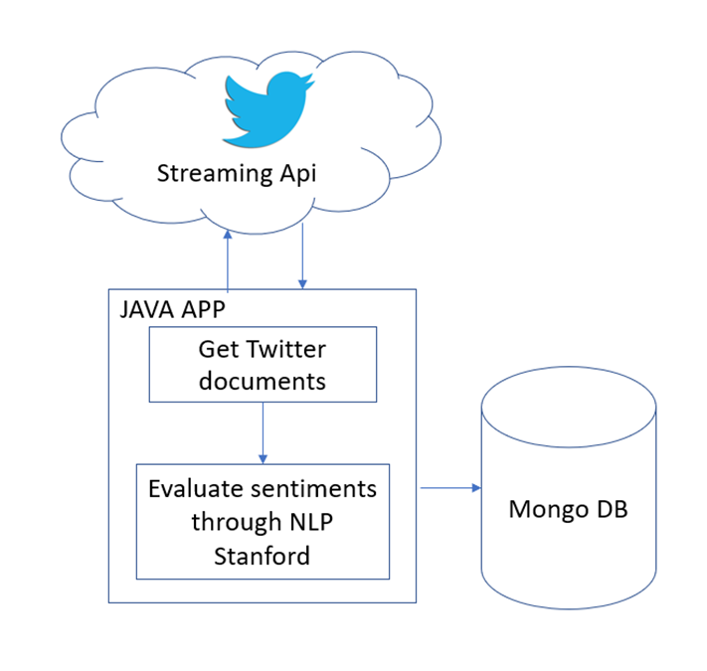
Business Intelligence (Data Science)
Process to extact twitter data
Data collection was achieved by login in twitter user account and going to the application site https://apps.twitter.com/which enable the researcher to create an application.
The keywords used to this problem were three different records because we evaluate three movies.

Slide 6
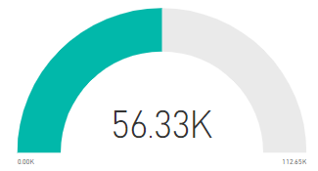
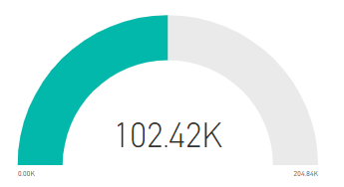
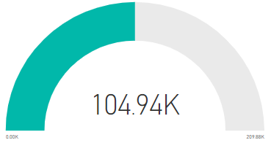
Business Intelligence (Data Science)
Results - Extraction
Ad Astra
Tweets: 56,326
First: 04/10/2019 04:46:06 am
Last: 08/10/2019 05:24:04 pm
Time: 5 days
Joker
Tweets: 102,422
First: 04/10/2019 06:27:28 am
Last: 05/10/2019 09:25:46 pm
Time: 2 days
Downton Abbey
Tweets: 104,941
First: 04/10/2019 03:13:53 am
Last: 06/10/2019 08:13:05 pm
Time: 3 days

Slide 7
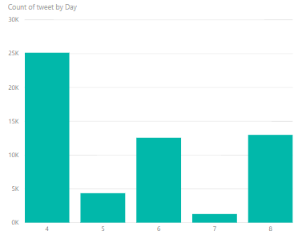
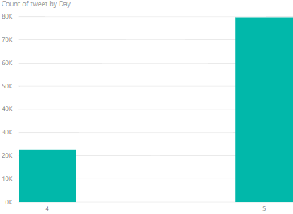
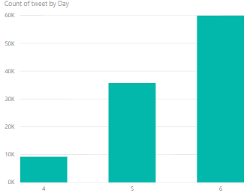
Business Intelligence (Data Science)
Ad Astra
Joker
Downton Abbey
Results – Count of tweet per day
From Octuber 4 to Octuber 8, 2019.

Slide 8
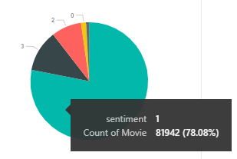
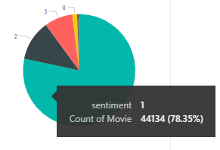
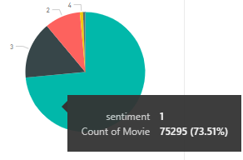
Business Intelligence (Data Science)
Ad Astra
Joker
Downton Abbey
Results – Sentiment
Sentiment rating:
0: Very Negative 1: Negative 2:Neutral 3: Positive 4: Very positive

Slide 9
Business Intelligence (Data Science)
Conclusions
Analyzing text data using Stanford’s CoreNLP, makes the analysis of data easy and efficient.
Most of the tweets shows some texts that gets a negative score due some words in the sentence has a negative effect. As we advance in score, we identify positive words and less appearance of negative words or sentences.
Natural Language Processing (NLP) is advancing and the sentiment analysis studies are increasing in the last years, though there are challenges for NLP like language diversity, satire and emoticon detection.

